Slide 1

Data Structures and Algorithms Instructor: Maira Sami
maira.sami@szabist.edu.pk
Campus 100
Room No. 101

Slide 2
Double Linked Lists

Slide 3
Doubly-linked lists
prev
next
Here is a doubly-linked list (DLL):
elem
node
header
nodes/positions
trailer
elements
Each node contains a value, a link to its successor (if any), and a link to its predecessor (if any)
The header points to the first node in the list and to the last node in the list (or contains null links if the list is empty)

Slide 4
Doubly Linked Lists
pHead
a
b
c
Advantages:
Convenient to traverse the list backwards.
Simplifies insertion and deletion because you no longer have to refer to the previous node.
Disadvantage:
Increase in space requirements.

Slide 5
Insertion
head
current
newNode = new Node(x);
newNode->prev = current;
newNode->next = current->next;
newNode->prev->next = newNode;
newNode->next->prev = newNode;
current = newNode;
newNode

Slide 6
Insertion
We visualize operation insertAfter(p, X), which returns position q
p
A
B
C
p
A
B
q
C
X
p
q
A
B
X
C

Slide 7
ALGORITHM FOR INSERTING A NODE
Suppose START is the first position in linked list. Let DATA be the element to be
inserted in the new node. POS is the position where the NewNode is to be inserted. TEMP
is a temporary pointer to hold the node address.
Input the DATA and POS
Initialize TEMP = START; i = 0
Repeat the step 4 if (i less than POS) and (TEMP is not equal to NULL)
TEMP = TEMP → RPoint; i = i +1
If (TEMP not equal to NULL) and (i equal to POS)
(a) Create a New Node
(b) NewNode → DATA = DATA
(c) NewNode → RPoint = TEMP → RPoint
(d) NewNode → LPoint = TEMP
(e) (TEMP → RPoint) → LPoint = NewNode
(f ) TEMP → RPoint = New Node
Else
(a) Display “Position NOT found”
7. Exit

Slide 8
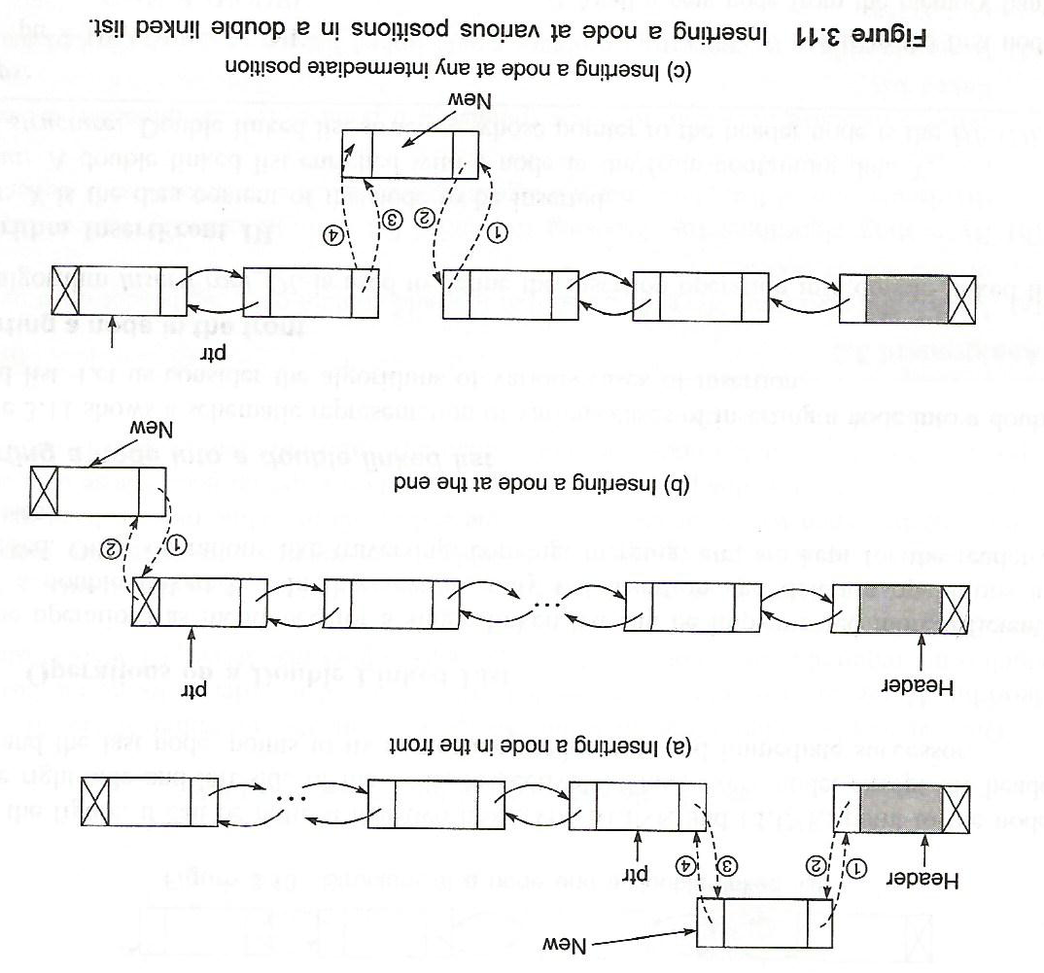

Slide 9
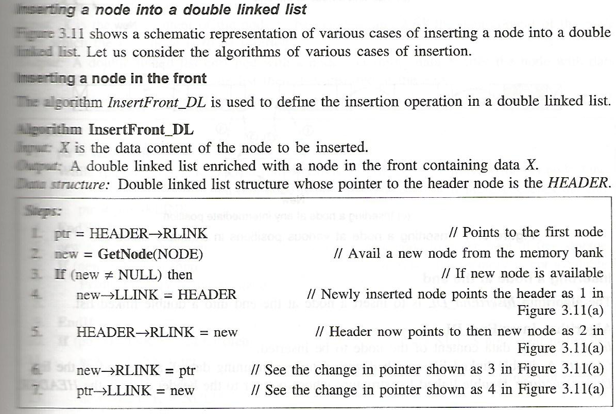
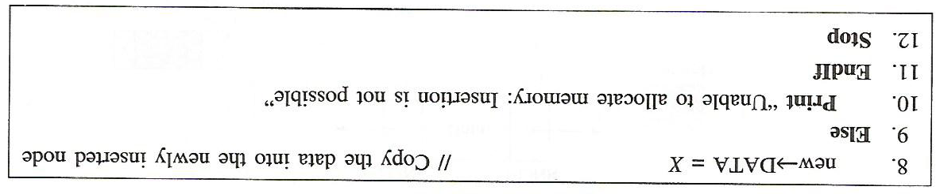

Slide 10
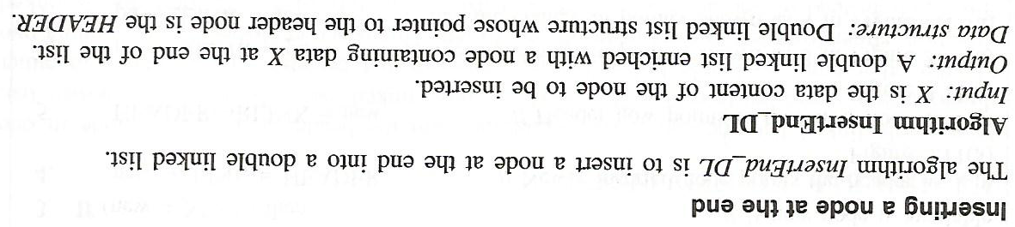
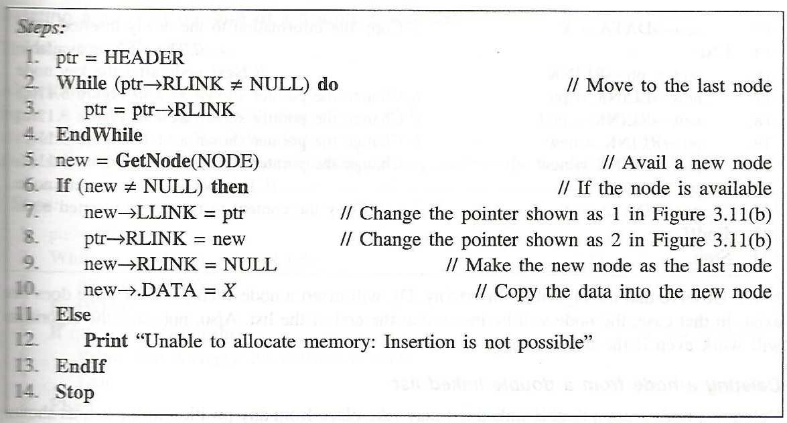

Slide 11
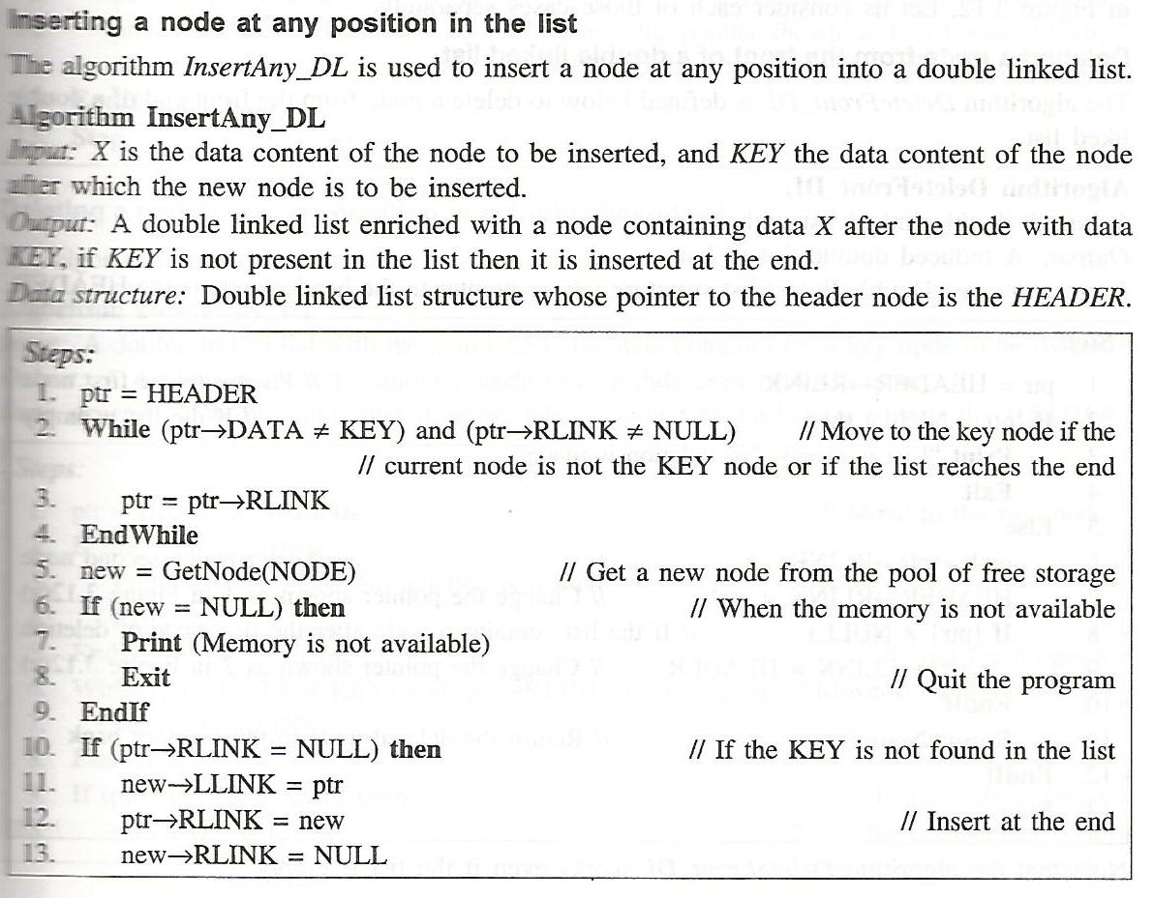

Slide 12
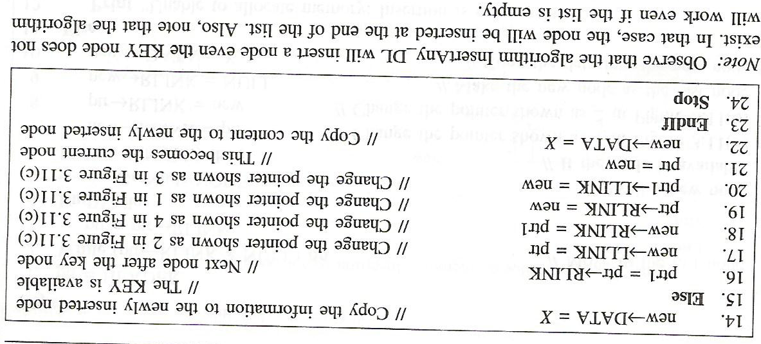

Slide 13
Deletion
We visualize remove(p), where p == last()
p
A
B
C
D
A
B
C
p
D
A
B
C

Slide 14
Deletion
head
current
oldNode = current;
oldNode->prev->next = oldNode->next;
oldNode->next->prev = oldNode->prev;
delete oldNode;
current = head;

Slide 15
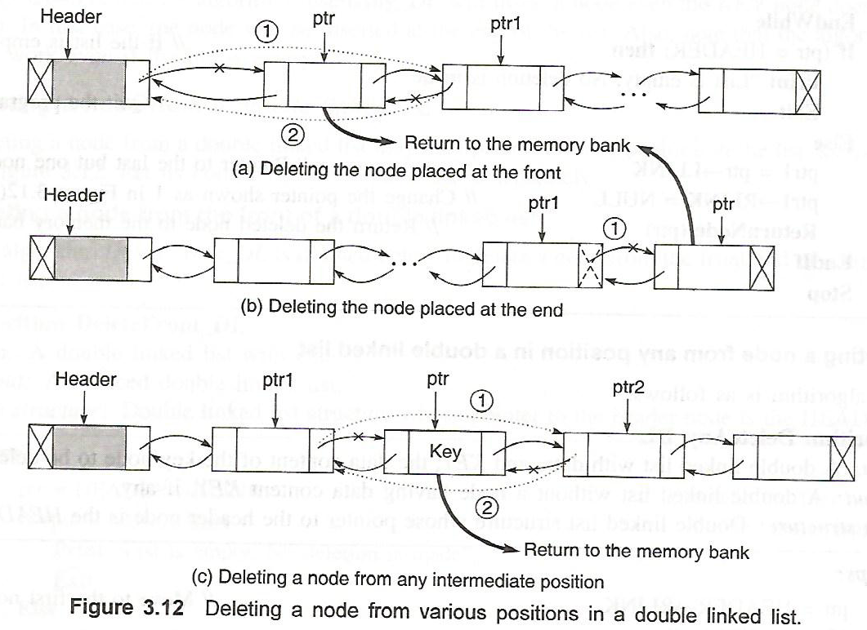

Slide 16
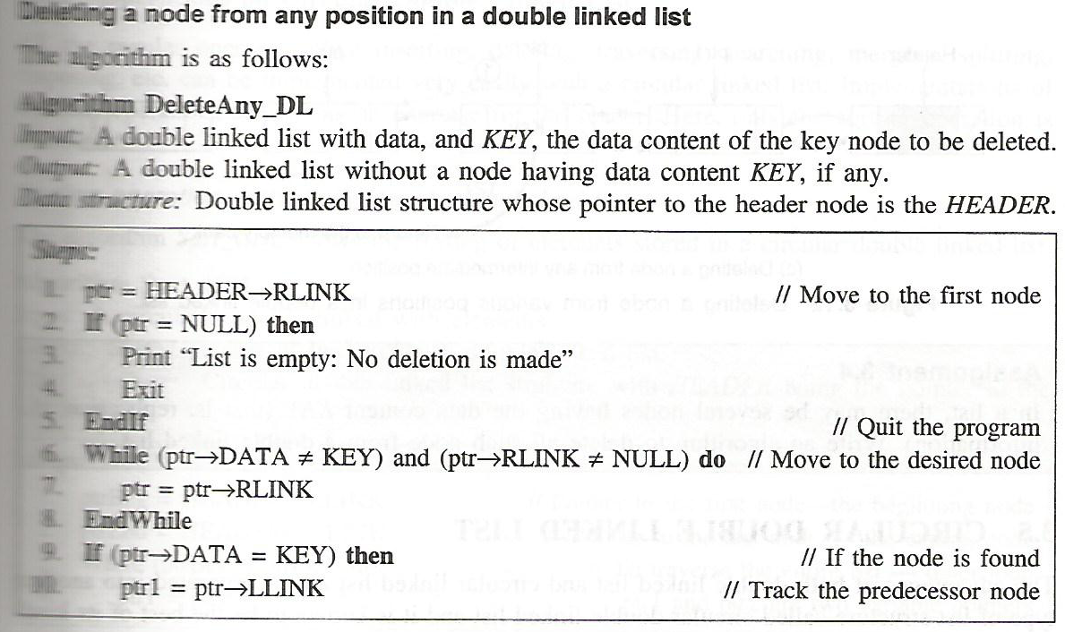
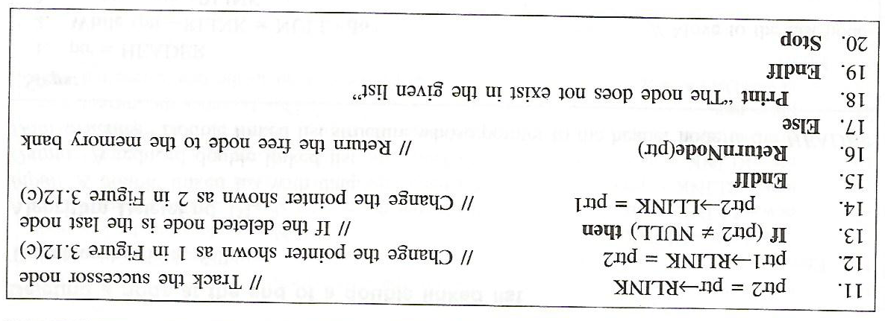

Slide 17
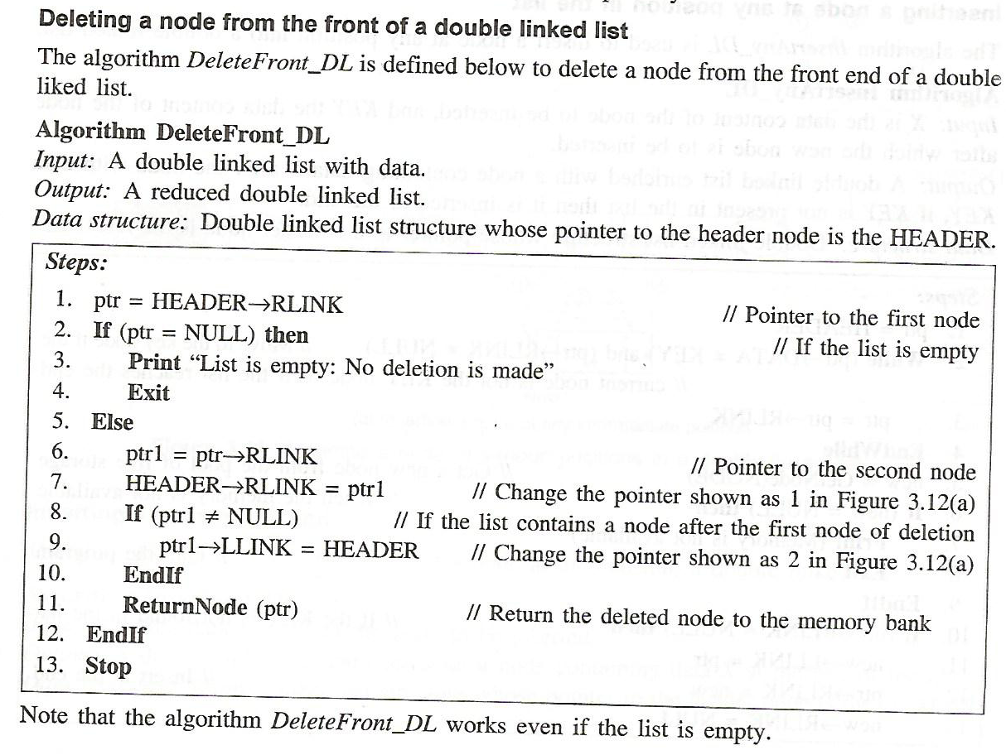

Slide 18
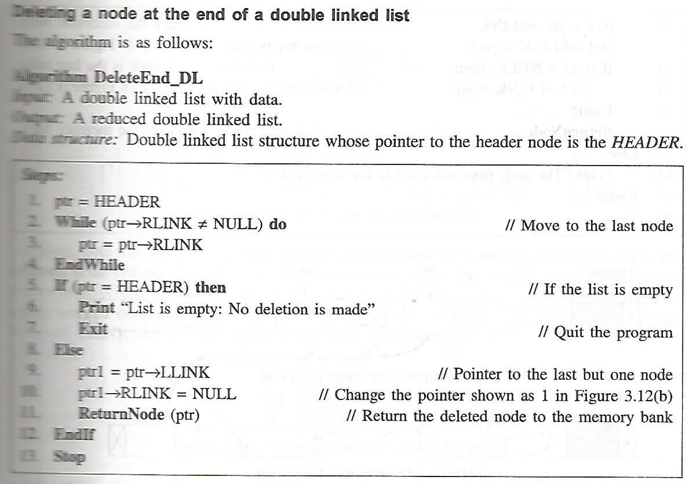

Slide 19
DLLs compared to SLLs
Advantages:
Can be traversed in either direction (may be essential for some programs)
Some operations, such as deletion and inserting before a node, become easier
Disadvantages:
Requires more space
List manipulations are slower (because more links must be changed)
Greater chance of having bugs (because more links must be manipulated)
Random access is time consuming

